Slide 1
Scaling a DISTRIBUTED SPATIAL CACHE OVERLAY
Alexander Gessler
Simon Hanna
Ashley Marie Smith

Slide 2

MOTIVATION
Location-based services utilize time and geographic behavior of user
geotagging photos
recommendations based on user location
Heavy usage of LBS → high demand for data
74% of smartphone owners “use their phone to get directions or information based on current location”
Load varies temporally and spatially
Anticipated workload – fewer queries at night
Spatial data skew – data denser in cities
http://www.imore.com/instagram-30-introduces-photo-map-and-improvements
Motivation: How to adapt to loads in distributed systems characterized by spatial data?

Slide 3
LOAD-BALANCING
Goal: Prevent decrease in system performance caused by unexpected, heavy workloads that are unevenly distributed.
Static
Use anticipated workloads statistics
Dynamic
Reduce data skew via migration and replication
Elastic load-balancing

Slide 4
SCALING
Scaling-Out: add resources, Scaling-In: remove resources
Unlike LB: maximum system throughput changes
Expensive: Must not use too often

Slide 5
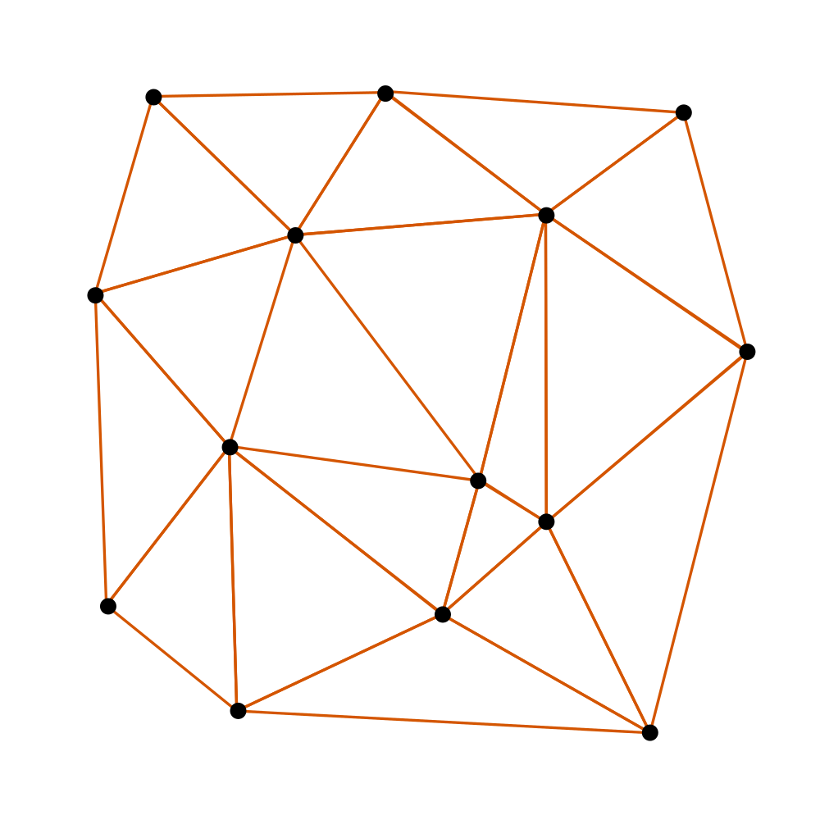

OUR PROJEKT-INF CONTEXT
A grid-based cache for spatial data
Partition spatial data into a 2D grid
Build distributed cache overlay on top
Topology: Delaunay triangulation
Greedy forwarding / routing
Dedicate cache nodes to cover grid partitions
Cache focus
http://commons.wikimedia.org/wiki/File:Delaunay-Triangulation.svg

Slide 6
Problem Statement
We investigate whether Scaling efficiently balances dynamic loads in a distributed spatial cache overlay.
Does the system scale under increasing query workload or does it need additional load-balancing mechanisms?
We quantify “efficient” by measuring response time in a real computer cluster.
Previous study done under a simulation without looking at response time.

Slide 7
Our Prototype
Suitable for deployment on a cluster
No real caching or query processing
We do have a “master” node (admin)
Handle initial overlay construction
Very lightweight → most tasks distributed
Aggregate a global “load” metric

Slide 8
How we handle QUERIES
From each AWQL query a single spatial coordinate can be extracted
Caller sends query to an arbitrary cache node.
Node greedily forwards query to closest node
Closest node simulates processing by sleeping 50ms
A “Response” is send to entry node and therefrom forwarded to caller.
No actual caching at this time (i.e. everything is a hit).

Slide 9
How we SCALE
High-load node periodically walks incident triangles and collects loads
If aggregate load > threshold:
Ensure mutual exclusion in area
Add node in triangle center
Have nearby nodes reset load estimates
Limitation: New cache node started locally
No Scaling-in implemented
{1.2, 0.8}
{1.2}
{1.2, 0.8, 1.0}

Slide 10
BENCHMARK
Experiment groups
A cache overlay with n nodes.
Over 10 seconds, each node receives k queries / s. We do this for two kinds of queries:
Uniform – target coordinate is uniformly distributed across the grid
Non-uniform – a tight Gaussian around an arbitrary point (σ = 18% grid size). Think hotspot around a big city.
We measure request latency (median + P95 mean)

Slide 11
RESULTS
Average load: Scaling-Out does not make things worse, but it also does not help.

Slide 12
RESULTS
High load: Scaling-Out preserves quasi-linear Scalability in the non-uniform case.

Slide 13
Future WORK - SCALING
Combine Elastic Load-Balancing + Scaling
Maintain global load metric. Use Elastic LB to handle relative load differences and Scaling to respond to global load changes.
Scaling-In
Yet to be done

Slide 14
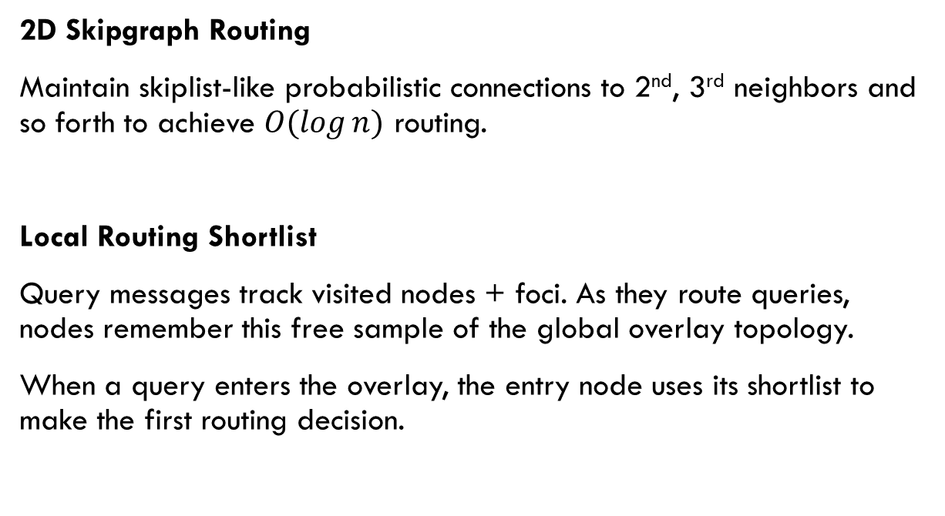
Future Work - ROUTING
2D Skipgraph Routing
Maintain skiplist-like probabilistic connections to 2nd, 3rd neighbors and so forth to achieve $Ο(\log{n})$ routing.
Local Routing Shortlist
Query messages track visited nodes + foci. As they route queries, nodes remember this free sample of the global overlay topology.
When a query enters the overlay, the entry node uses its shortlist to make the first routing decision.

Slide 15
FUTURE WORK
Goal: Contribute paper to GI Informatiktage-2014
“Big (Data) is beautiful”

